Slide 1
Service Fabric Microservices
A microservice is whatever you want it to be:
ASP.NET, node.js, Java VMs, an arbitrary .exe
Stateless microservices
A microservice that has state where the state is persisted to external storage, such as Azure databases or Azure storage
Stateful microservices
Reliability of state through replication and local persistence
Reduces the complexity and number of components in traditional three-tier architecture

Slide 2
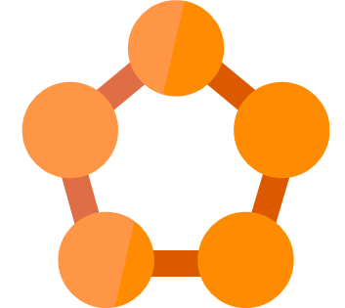

Azure Service Fabric
Hyperscale Microservices
platform
Managed platform
High productivity development
Built-in auto scale and load balancing
High availability with auto-patching
Simple
Programming models for
.NET, Java
Stateful
microservices
Highly scalable
24 X 7 availability
Health &
Monitoring
Available on
Private cloud,
Public Cloud &
Hosted Cloud
Learn easily using
Party clusters
Simple tooling with
Visual Studio,
Eclipse &
Yeoman
Windows and Linux
Container
Orchestration
DevOps and
Lifecycle management

Slide 3
Service type
Services types are composed of code/config/data packages
Code packages define an entry point (dll or exe)
Config packages define service specific config information
Data packages define static resources (eg. images)
Packages can be independently versioned
<ServiceManifest Name="QueueService" Version="1.0">
<ServiceTypes>
<StatefulServiceType ServiceTypeName="QueueServiceType" HasPersistedState="true" />
</ServiceTypes>
<CodePackage Name="Code" Version="1.0">
<EntryPoint>
<ExeHost>
<Program>ServiceHost.exe</Program>
</ExeHost>
</EntryPoint>
</CodePackage>
<ConfigPackage Name="Config" Version="1.0" />
<DataPackage Name="Data" Version="1.0" />
</ServiceManifest>
Service Type 1
Code
Config
Data

Slide 4
Application type
Declarative template for creating an application
Based on a set of service types
Used for packaging, deployment, and versioning
Application Type A
Service Type 1
Service Type 2
Service Type 3
Code
Config
Data
Code
Config
Data
Code
Config
Data

Slide 5
Design web applications
Notes:
https://docs.microsoft.com/en-us/azure/architecture/reference-architectures/app-service-web-app/

Slide 6
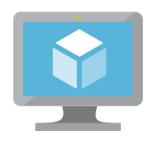
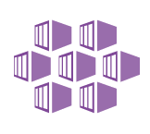
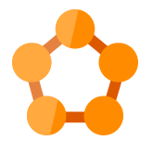

Azure: The Power Of Choice
Compute
Virtual Machines
Container Service
Service Fabric
App Service
More Control
Focus on the App
Customer-managed
(IaaS)
Platform-managed
(PaaS)
Notes:
Azure provides several cloud-based compute offerings to run your application so that you don't have to worry about the infrastructure details.
You can easily scale up or scale out your resources as your application usage grows. Azure offers services that cover the spectrum—from providing infrastructure-as-a-service (IaaS) to give you full control over your application hosting, through platform-as-a-service (PaaS) where the services are hosted for you, to true serverless hosting where all you need to do is write your code.

Slide 7
Azure App Service
Enterprise-grade apps
Fully managed platform
High productivity development
Global data center footprint
Hybrid support
Built-in auto scale and load balancing
High availability with auto-patching
.NET, Java, PHP, Node, and Python
Staging and deployment
Source code control integration
AAD integrated
Secure + compliant
Reduced operations costs
Backup and recovery
App gallery marketplace

Slide 8
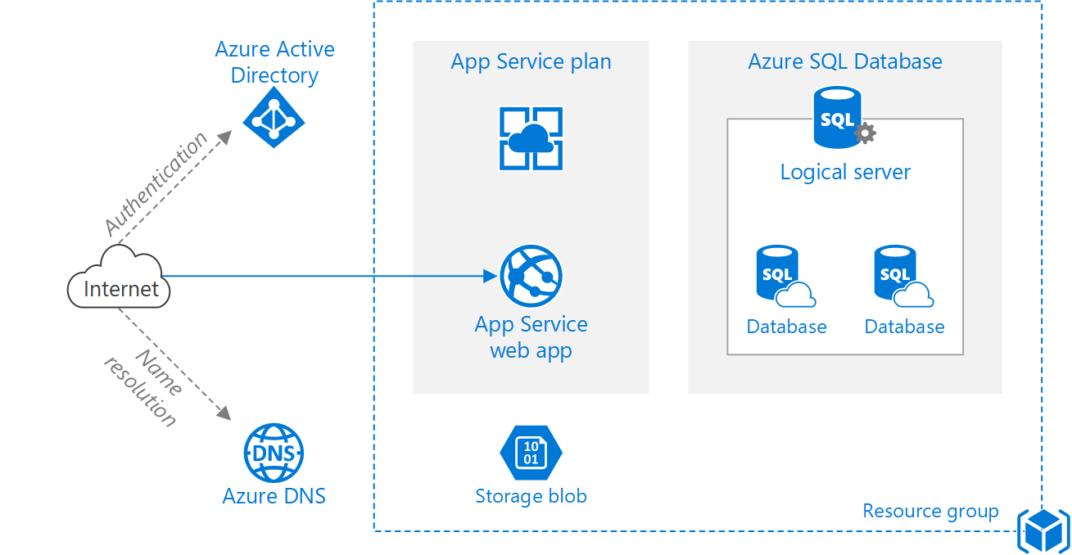
Basic
Notes:
https://docs.microsoft.com/en-us/azure/architecture/reference-architectures/app-service-web-app/basic-web-app

Slide 9
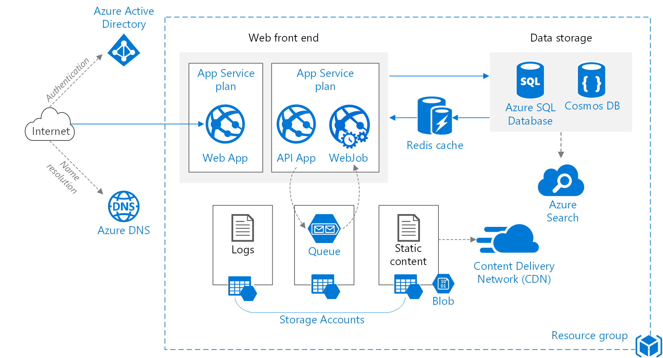
Improved Scalability
Notes:
https://docs.microsoft.com/en-us/azure/architecture/reference-architectures/app-service-web-app/scalable-web-app

Slide 10
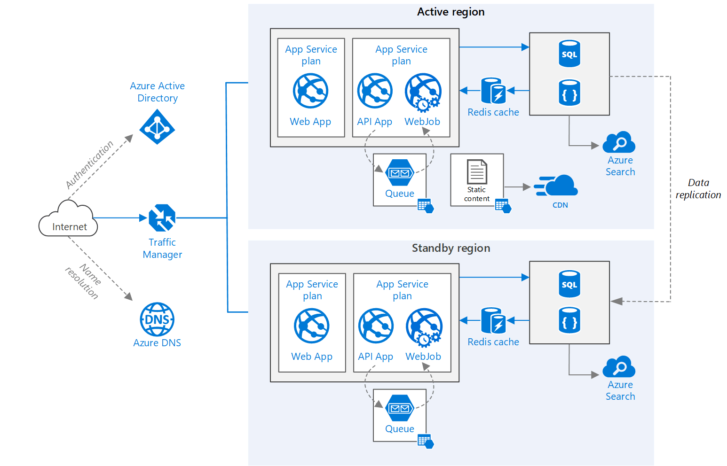
Multi-region
Notes:
https://docs.microsoft.com/en-us/azure/architecture/reference-architectures/app-service-web-app/multi-region

Slide 11
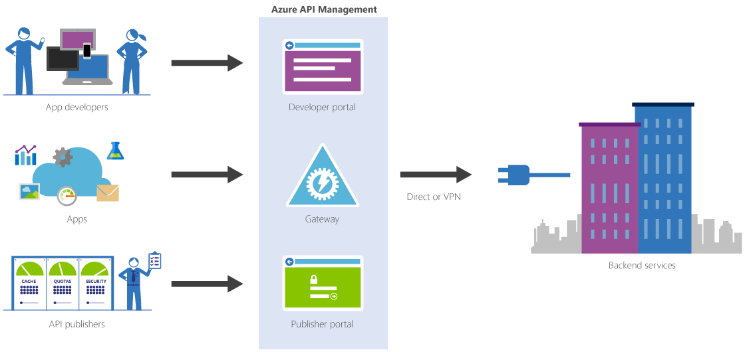
Azure API Management
Notes:
https://azure.microsoft.com/en-us/services/api-management/

Slide 12
Design solutions for serverless computing

Slide 13

Azure: The Power Of Choice
Compute
Virtual Machines
Container Service
Service Fabric
App Service
Functions
More Control
Focus on the App
Customer-managed
(IaaS)
Platform-managed
(PaaS)
Code-only
(serverless)
Notes:
Azure provides several cloud-based compute offerings to run your application so that you don't have to worry about the infrastructure details.
You can easily scale up or scale out your resources as your application usage grows. Azure offers services that cover the spectrum—from providing infrastructure-as-a-service (IaaS) to give you full control over your application hosting, through platform-as-a-service (PaaS) where the services are hosted for you, to true serverless hosting where all you need to do is write your code.

Slide 14
What is “serverless” and proposed Benefits
Abstraction of servers
Event-driven scale
Sub-second billing
Notes:
Abstraction of servers, infrastructure and configuration of operating system
Event-driven scale
Sub-second billing
Stateless
Serverless compute is a fully managed service. Some refer to it as Functions as a Service
OS and Framework patching is performed for you
There is zero administrative tasks and no need to manage any infrastructure
You just deploy your code (function) and it runs
Your code runs within seconds and for very short period of time
Serverless compute scales quickly (almost instantly) and vastly
Automatically scales within seconds
No scale configuration is required (there is no way to configure scale or limits)
Scales to match any given workload. Scales from zero to handle tens of thousands concurrent functions invocations within seconds
Pay only for the time your code is running
Serverless compute reacts to events
React, in near real-time, to events and triggers
Triggered by virtually any event from Azure service or 3rd party services
“Pinnacle of PaaS compute”
Not just hardware “servers”, but software servers are also managed for you
Focus on business logic, not solving technical problems not core to business
Lower effort to get started makes it easier to experiment (bots, etc.)

Slide 15
Applications
Example: Timer based processing
Eve
r
y 15 minutes
Find and clean invalid data
Clean table
Notes:
Signs that a serverless pattern might be useful for a given scenario
Stateless → Scale
Not worth deploying a traditional backend
Workload is sporadic (very low & high scale)
Dev ops favored versus dedicated ops
Lots of different services involved that need “glue”

Slide 16
Applications
Example: Azure service event processing
CSV
File added to
T
ransfo
r
m CSV to data
r
ows
P
ower BI
Blob Storage
Cha
r
t graphic

Slide 17
Applications
Example: SaaS event processing
Excel file saved
Mic
r
os
o
f
t Graph API analyzes content
C
r
eates new sheets
to OneDrive
with cha
r
ts

Slide 18
Applications
Example: Serverless Web Applications architectures
Loaded web page
C
r
eate ad based on user p
r
o
file
Completed page
calls
W
ebHook

Slide 19
Async background processing
Example: Serverless Mobile back ends
Photo taken and
Sto
r
es in blob storage
P
r
W
ebHook called
oduces scaled images

Slide 20
Applications
Example: Real-time stream processing
Millions
o
f devices feed
T
ransfo
r
m to structu
r
ed data
Sto
r
e data in
into St
r
eam Analytics
SQL Online

Slide 21
Applications
Example: Real-time bot messaging
...
?
Co
r
tana Analytics answe
r
Message sent
s questions
Chatbot sends
to Chatbot
r
esponse

Slide 22


Integration
Example: Invoice Processing
API Management
Logic App
Function
Post new invoice
Convert to JSON
Grab raw file
Store record
API layer
Fetch Invoice
Notes:
Chris

Slide 23
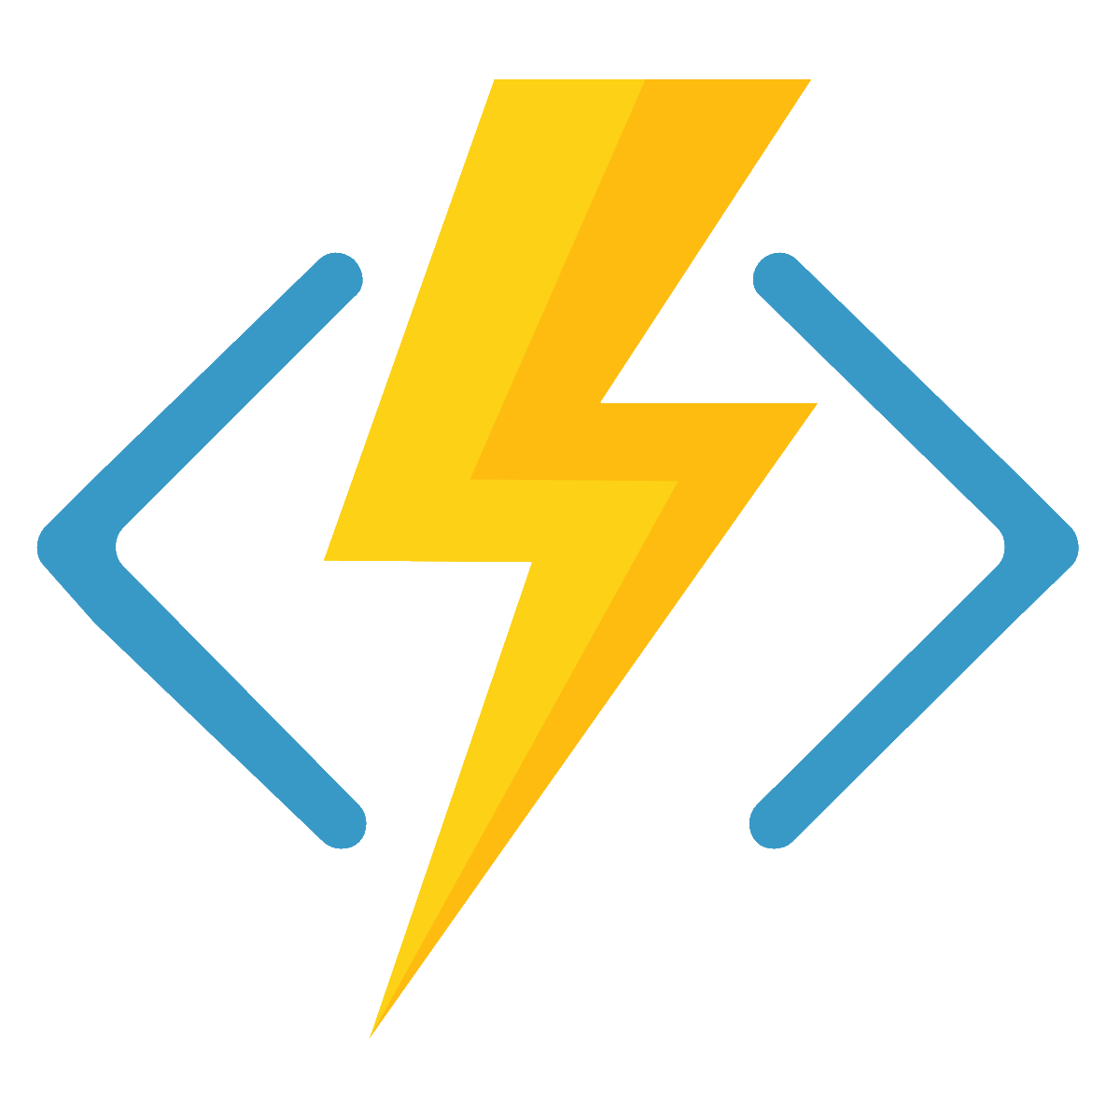







Azure Functions
Serverless
Accelerate development
Bind into services
Azure Service Bus
Azure Event Hub
Azure Storage
</>
Dropbox
Sendgrid
AzureDocDb
Event-driven scale
Reduced Dev Ops
Develop your way
Local development
OneDrive
Box
Twilio

Slide 24
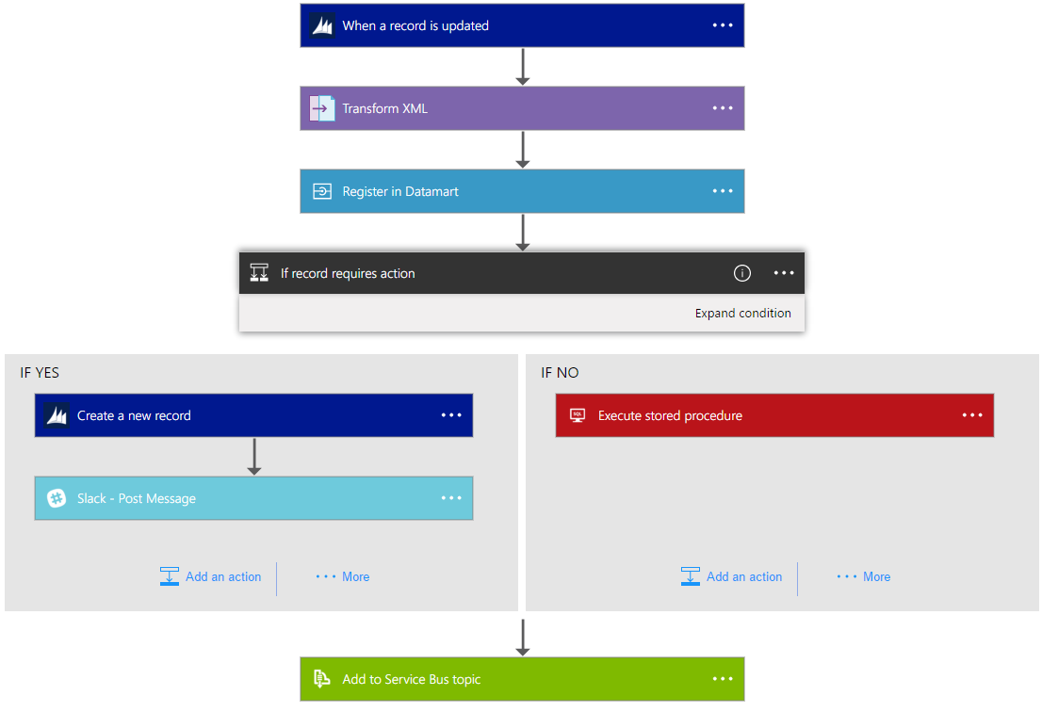
Azure Logic Apps
Notes:
https://docs.microsoft.com/en-us/azure/logic-apps/logic-apps-what-are-logic-apps

Slide 25
Azure: The Power Of Choice
Compute
Virtual Machines
Container Service
Service Fabric
App Service
Functions
More Control
Focus on the App
Customer-managed
(IaaS)
Platform-managed
(PaaS)
Code-only
(serverless)
Notes:
Azure provides several cloud-based compute offerings to run your application so that you don't have to worry about the infrastructure details.
You can easily scale up or scale out your resources as your application usage grows. Azure offers services that cover the spectrum—from providing infrastructure-as-a-service (IaaS) to give you full control over your application hosting, through platform-as-a-service (PaaS) where the services are hosted for you, to true serverless hosting where all you need to do is write your code.

Slide 26
Summarizing the options
Service | Best used for…
VMs | Lift-and-shift for a set of “pets”
VM Scale Sets | Scaling and managing a set of identical VMs
Batch | Highly parallelized computation
Container Service | Deploying and managing a set of arbitrary Linux containers
Container Instances | Running individual containers with low overhead and no VM management
Service Fabric | Building microservice-based applications on Windows using .NET
App Service | Building standard web and mobile apps with limited management responsibilities
Functions | Building small, event-driven software with granular auto-scale

Slide 27
Create compute-intensive application
Notes:
https://azure.microsoft.com/en-us/services/batch/
https://docs.microsoft.com/en-us/azure/virtual-machines/linux/high-performance-computing

Slide 28
WHAT IS HIGH PERFORMANCE COMPUTING?
Risk Simulations
Food & beverages
Automotive
Weather forecasting
Academia
Fluid dynamics
Graphics & rendering
Banking
Oil & Gas
Defense & Aerospace
Oceaneering
Deep Learning
Crash Simulations
HPC
Insurance
Ship engineering
Pharmaceutical
Healthcare
Molecular Modelling
Structural
simulations
Genomics
Chemical engineering
Energy
Engineering & construction
Bio Science
Notes:
Before we commence with the actual pitch for HPC or High Performance Computing, I’d like to take a moment and just address a few high-level points to help position HPC within MSFT and how our strategy is currently aligned to this particular scenario.
HPC is not a solution per se, more of a way to deal with computational problems. It spans a great many industries, that each have preferred solutions or ways of using HPC depending on their area or business.
Common for HPC, whether we are in financial services or insurance calculating risk across large portfolios of policies, pricing of an instrument to calculating the airflow and dynamics or crash testing of a new car the need for massive compute power is crucial.
The very definition of HPC, is the ability to break a large computational problem into many smaller bits, and by using a cluster of computers have a massive amount of CPUs or GPUs work on the problem in parallel, outputting your results at the end.
Since HPC spans a lot of verticals and application needs, let’s take a brief look at what our strategy is.

Slide 29
Cloud value for big compute
Scale
Elasticity
Pay for use
Reach & locality
Hardware selection
No infrastructure
Known costs

Slide 30
Azure Batch Concepts
Queue
Jobs & Tasks
Applications / Algorithms
Pool of VMs
INPUT
OUTPUT
Notes:
When you have an application that runs many tasks, these tasks can be assigned to run on different computers (or virtual machines—VMs—in the case of a cloud), so that they can run in parallel. These tasks can run independently or are coupled to each other (i.e., one tasks needs another task’s results to start running or complete). Throughout the task-running process, data is read, computed and written by the tasks.

Slide 31
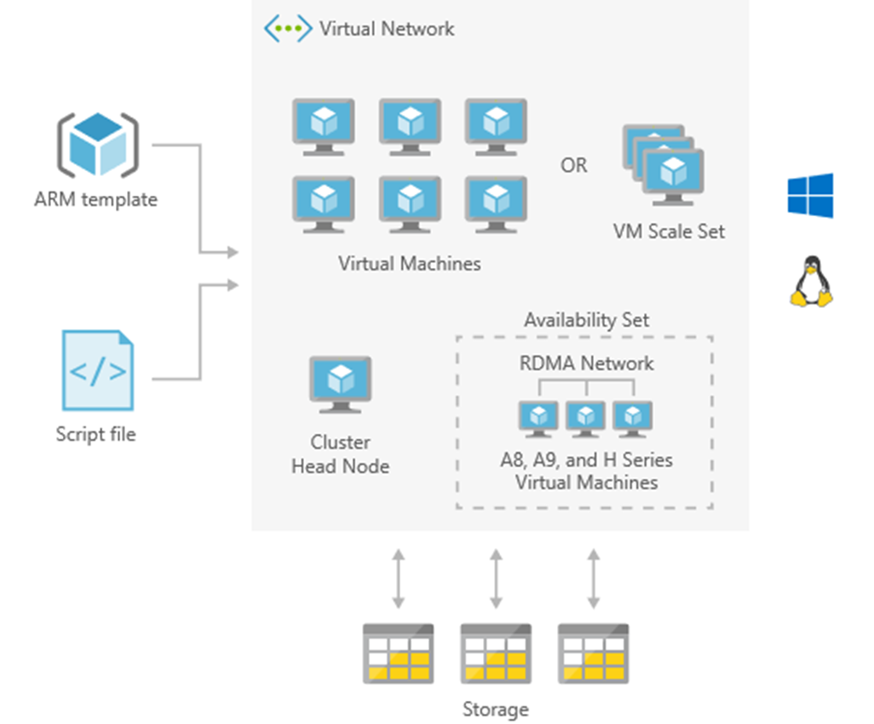
HPC cluster deployed in the cloud
Solution architecture
High performance computing (HPC) applications can scale to thousands of compute cores, extend on-premises big compute, or run as a 100% cloud native solution. This HPC solution including the head node, compute nodes, and storage nodes, runs in Azure with no hardware infrastructure to maintain.
This solution is built on the Azure managed services: Virtual Machine Scale Sets, Virtual Network and Storage. These services run in a high-availability environment, patched and supported, allowing you to focus on your solution instead of the environment they run in.

Slide 32
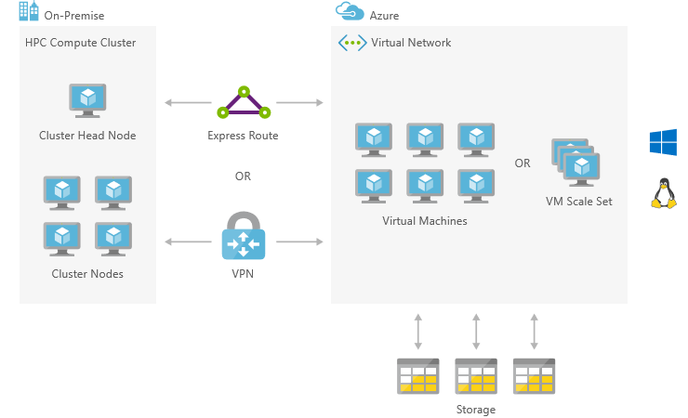
On-premises HPC implementation bursting to Azure
Solution architecture
High performance computing (HPC) applications can scale to thousands of compute cores, extend on-premises big compute, or run as a 100% cloud native solution. This HPC solution can extend its computational capacity by leveraging the compute-intensive instances of Virtual Machines running in Azure and accessed via Express Route or VPN.
This solution is built on the Azure managed services: Virtual Machines, Virtual Network, VPN Gateway, ExpressRoute and Storage. These services run in a high-availability environment, patched and supported, allowing you to focus on your solution instead of the environment they run in.

Slide 34
Appendix

Slide 35
VMs – Supported Operating Systems
Linux distributions and versions supported on Azure
Linux
CentOS
CoreOS
Debian
Oracle
Red Hat
SUSE
openSUSE
Ubuntu
Windows Server
Windows 2003* https://support.microsoft.com/en-us/help/3206074
Windows 2008R2+
Distribution | Version | Drivers | Agent
CentOS | CentOS 6.3+, 7.0+ | CentOS 6.3: LIS download CentOS 6.4+: In kernel | Package: In repo under "WALinuxAgent" Source code: GitHub
CoreOS | 494.4.0+ | In kernel | Source code: GitHub
Debian | Debian 7.9+, 8.2+ | In kernel | Package: In repo under "waagent" Source code: GitHub
Oracle Linux | 6.4+, 7.0+ | In kernel | Package: In repo under "WALinuxAgent" Source code: GitHub
Red Hat Enterprise Linux | RHEL 6.7+, 7.1+ | In kernel | Package: In repo under "WALinuxAgent" Source code: GitHub
SUSE Linux Enterprise | SLES/SLES for SAP 11 SP4 12 SP1+ | In kernel | Package: for 11 in Cloud:Tools repo for 12 included in "Public Cloud" Module under "python-azure-agent" Source code: GitHub
openSUSE | openSUSE Leap 42.1+ | In kernel | Package: In Cloud:Tools repo under "python-azure-agent" Source code: GitHub
Ubuntu | Ubuntu 12.04, 14.04, 16.04, 16.10 | In kernel | Package: In repo under "walinuxagent" Source code: GitHub
Notes:
https://docs.microsoft.com/en-us/azure/virtual-machines/linux/endorsed-distros
Bring your own image for windows server 2003

Slide 36
VM Scaling
Resize VMs (Scale up or down)
Offline operation
Just a reboot if in a cluster that supports new size
Requires a deallocation if new size is not supported in the cluster (a little longer)
Scale In or Out
You can create new instances of the VM based on platform images (max 1000) or your own custom images (max 100)
Using VM Scale Sets
Using Azure Automation
Scheduled
Azure Autoscale
System Metrics (CPU, RAM, etc)
Custom Metrics
Notes:
If the VM is part of an availability set and the new size is not supported in the cluster, all VMs in the availability set will need to be deallocated for the resize to happen
https://docs.microsoft.com/en-us/azure/virtual-machines/windows/resize-vm
- Azure Autoscale
System Metrics (CPU, RAM, etc)
Custom Metrics https://docs.microsoft.com/en-us/azure/monitoring-and-diagnostics/monitoring-overview-autoscale#resource-metrics
Scale
Up/Down
In/Out

Slide 37
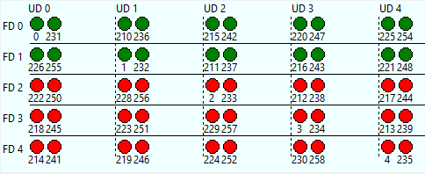
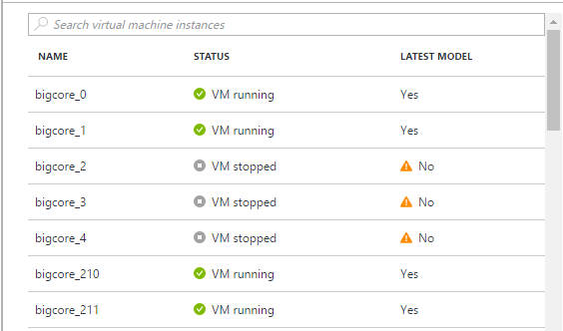
Virtual Machine Scale Sets
Deploy and manage VMs as a set
An Azure Compute resource Microsoft.Compute/virtualMachineScaleSets
Scale - Deploy identical resources
Easily
Rapidly
At scale.. 10s – 10,000s of cores
Low cost - Dynamically increase/decrease compute power to optimize costs
Elasticity - Automatically scale to changing demand
Notes:
https://azure.microsoft.com/en-us/documentation/services/virtual-machines-scale-sets
Design Considerations For Scale Sets
https://docs.microsoft.com/en-us/azure/virtual-machine-scale-sets/virtual-machine-scale-sets-design-overview

Slide 38
VM Disks
Disks can be resized up to 4TB
Managed Vs Unmanaged.
Encryption
Disk Caching
None – for Write only and Write heavy (SQL Logs)
ReadOnly – for Read only or read-intensive disks (SQL Data files)
ReadWrite – for Operating System disks
Notes:
Disk and Azure Storage pricing: https://azure.microsoft.com/en-us/pricing/details/storage/blobs/
Encryption: https://docs.microsoft.com/en-us/azure/security/azure-security-disk-encryption#disk-encryption-deployment-scenarios-and-user-experiences
IaaS VMs are secured at rest, because you can use industry-standard encryption technology to address organizational security and compliance requirements.
IaaS VMs boot under customer-controlled keys and policies, and you can audit their usage in your key vault.
Managed disks: https://docs.microsoft.com/en-us/azure/virtual-machines/windows/managed-disks-overview
Managed disks are encrypted by default

Slide 39
VM Disks
Images are representations of your VM that you can use to create more instances of the VM
You can capture an Image of a VM and it will include all the disks
Snapshots only capture one disk at a time.
Disk Snapshots let you capture current state copies of your disks.
Managed Disks: Take Snapshots of the disk
Unmanaged Disks: Take Snapshots of the underlying VHD blob
Notes:
You can capture an Image of a VM and it will include all the disks. https://docs.microsoft.com/en-us/azure/virtual-machines/windows/capture-image-resource
Managed Disks: Take Snapshots of the disk https://docs.microsoft.com/en-us/azure/storage/storage-managed-disks-overview#images-versus-snapshots
Unmanaged Disks: Take Snapshots of the underlying VHD blob https://docs.microsoft.com/en-us/azure/storage/storage-incremental-snapshots

Slide 40
Exam Tip - Increase size of existing Disks
You can easily increase the size of existing disks. For example, you might want to increase the size of a 30-GB disk to 128 GB, or even to 4 TB. Or, you might want to convert your P20 disk to a P30 disk because you need more capacity or more IOPS and throughput.
Notes:
https://docs.microsoft.com/en-us/azure/storage/storage-premium-storage#scalability-and-performance-targets

Slide 41
ARM Templates
Notes:
Patterns for defining complex templates -https://docs.microsoft.com/en-us/azure/azure-resource-manager/best-practices-resource-manager-design-templates

Slide 42
Azure Resource Manager (ARM)
Enable application management within Azure
Resource groups are containers that can contain multiple IaaS + PaaS resources
Support lifecycle management with integrated Role Based Access Control (RBAC)
Templatize application deployment and configuration
Supports DevOps
RESOU
R
CE G
R
OUP
Notes:
All the resources in your resource group should share the same lifecycle. You deploy, update, and delete them together. If one resource, such as a database server, needs to exist on a different deployment cycle it should be in another resource group.
Each resource can only exist in one resource group.
You can add or remove a resource to a resource group at any time.
You can move a resource from one resource group to another group. For more information, see Move resources to new resource group or subscription.
A resource group can contain resources that reside in different regions.
A resource group can be used to scope access control for administrative actions.
A resource can interact with resources in other resource groups. This interaction is common when the two resources are related but do not share the same lifecycle (for example, web apps connecting to a database).

Slide 43
Azure Resource Manager
Describe
WHERE Resource Inventory
WHAT Component Relationships
HOW Tags + links + groups
Provision
WHERE Across Regions
WHAT Across Resources
HOW In service and in guest
Control
WHO Access control
WHAT Changes
HOW RBAC

Slide 44
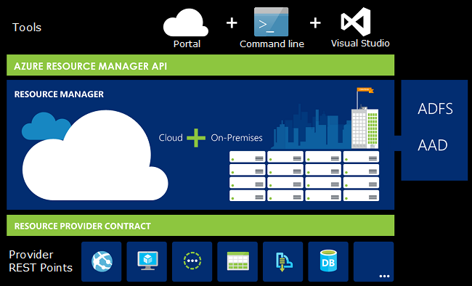
What is ARM?
Resource
Resource Group
Resource Provider
Resource Manager Template
Notes:
https://docs.microsoft.com/en-us/azure/azure-resource-manager/resource-group-overview
The following image shows how all the tools interact with the same Azure Resource Manager API. The API passes requests to the Resource Manager service, which authenticates and authorizes the requests. Resource Manager then routes the requests to the appropriate resource providers.
If you are new to Azure Resource Manager, there are some terms you might not be familiar with.
resource - A manageable item that is available through Azure. Some common resources are a virtual machine, storage account, web app, database, and virtual network, but there are many more.
resource group - A container that holds related resources for an Azure solution. The resource group can include all the resources for the solution, or only those resources that you want to manage as a group. You decide how you want to allocate resources to resource groups based on what makes the most sense for your organization. See Resource groups.
resource provider - A service that supplies the resources you can deploy and manage through Resource Manager. Each resource provider offers operations for working with the resources that are deployed. Some common resource providers are Microsoft.Compute, which supplies the virtual machine resource, Microsoft.Storage, which supplies the storage account resource, and Microsoft.Web, which supplies resources related to web apps. See Resource providers.
Resource Manager template - A JavaScript Object Notation (JSON) file that defines one or more resources to deploy to a resource group. It also defines the dependencies between the deployed resources. The template can be used to deploy the resources consistently and repeatedly. See Template deployment.
declarative syntax - Syntax that lets you state "Here is what I intend to create" without having to write the sequence of programming commands to create it. The Resource Manager template is an example of declarative syntax. In the file, you define the properties for the infrastructure to deploy to Azure.

Slide 45
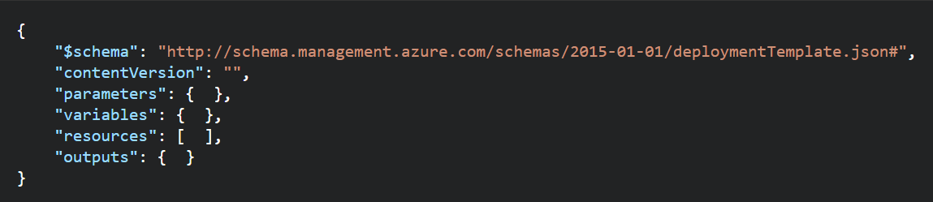
ARM Templates - Structure
Element name | Required | Description
$schema | Yes | Location of the JSON schema file that describes the version of the template language. Use the URL shown in the preceding example.
contentVersion | Yes | Version of the template (such as 1.0.0.0). You can provide any value for this element. When deploying resources using the template, this value can be used to make sure that the right template is being used.
parameters | No | Values that are provided when deployment is executed to customize resource deployment.
variables | No | Values that are used as JSON fragments in the template to simplify template language expressions.
resources | Yes | Resource types that are deployed or updated in a resource group.
outputs | No | Values that are returned after deployment.
Notes:
https://docs.microsoft.com/en-us/azure/azure-resource-manager/resource-group-authoring-templates

Slide 46
Template Deployment Mode
Complete: Resource Manager deletes resources that exist in the resource group but are not specified in the template.
Incremental: Resource Manager leaves unchanged resources that exist in the resource group but are not specified in the template.

Slide 47
Existing Resource Group
contains:
Resource A
Resource B
Resource C
Template defines:
Resource A
Resource B
Resource D
When deployed in incremental mode, Resource C is deleted. The resource group contains:
Resource A
Resource B
Resource C
Resource D
When deployed in complete mode, Resource C is deleted. The resource group contains:
Resource A
Resource B
Resource D
To use complete mode, use the Mode parameter
Notes:
New-AzureRmResourceGroupDeployment -Mode Complete -Name ExampleDeployment ` -ResourceGroupName ExampleResourceGroup -TemplateFile c:\MyTemplates\storage.json

Slide 48
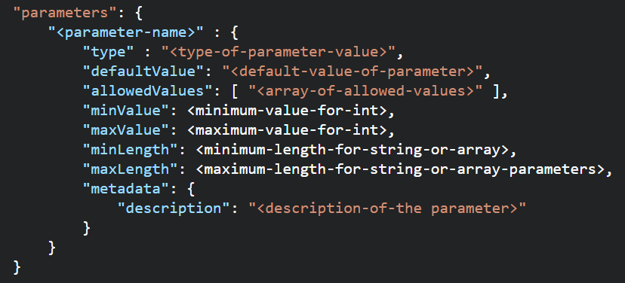
ARM Templates - Parameters
Element name | Required | Description
parameterName | Yes | Name of the parameter. Must be a valid JavaScript identifier.
type | Yes | Type of the parameter value. See the list of allowed types after this table.
defaultValue | No | Default value for the parameter, if no value is provided for the parameter.
allowedValues | No | Array of allowed values for the parameter to make sure that the right value is provided.
minValue | No | The minimum value for int type parameters, this value is inclusive.
maxValue | No | The maximum value for int type parameters, this value is inclusive.
minLength | No | The minimum length for string, secureString, and array type parameters, this value is inclusive.
maxLength | No | The maximum length for string, secureString, and array type parameters, this value is inclusive.
description | No | Description of the parameter that is displayed to users through the portal.
Allowed Types
string
secureString
int
bool
object
secureObject
array
Notes:
In the parameters section of the template, you specify which values you can input when deploying the resources. These parameter values enable you to customize the deployment by providing values that are tailored for a particular environment (such as dev, test, and production). You do not have to provide parameters in your template, but without parameters your template would always deploy the same resources with the same names, locations, and properties.

Slide 49
Re-use ARM Templates
By passing in parameters to your ARM Templates, you can re-use them in many different scenarios. You can deploy full solutions with t-shirt sizing (Small, Medium, Large) based on parameters you pass in: Size of VM, # of VMs, etc.
Be aware of what values in the ARM template need to be unique when re-using templates: https://docs.microsoft.com/en-us/azure/azure-resource-manager/resource-manager-template-best-practices#resource-names
https://docs.microsoft.com/en-us/azure/azure-resource-manager/best-practices-resource-manager-design-templates

Slide 50
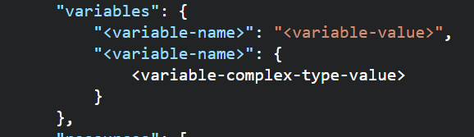
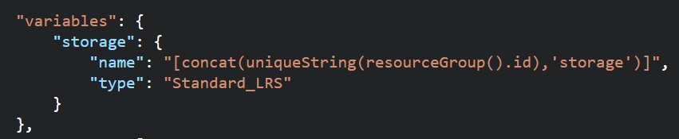
ARM Templates –Variables
Use Variables for
Use variables for values that you need to use more than once in a template.
Include variables for resource names that must be unique.
Use variables for extra manipulation of parameters
You can group variables into complex objects. Use the variable.subentry format to reference a value from a complex object.
Notes:
https://docs.microsoft.com/en-us/azure/azure-resource-manager/resource-manager-template-best-practices#variables

Slide 51
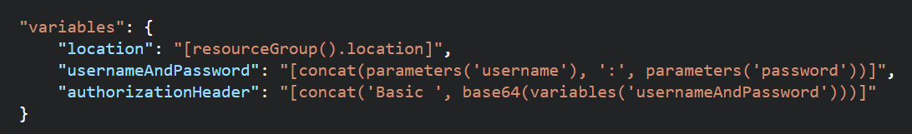
ARM Templates – Functions and Expressions
Templates are JSON
Functions and Expressions extend the JSON capabilities
They let you use some coding notions inside your templates to create or evaluate dynamic values
Functions you see often:
concat – concatenates multiple values
copyIndex – returns the index of an iteration loop
resourceGroup – access properties of this resource group, like the location.
resourceId – get the unique identifier for a resource.
All Functions: https://docs.microsoft.com/en-us/azure/azure-resource-manager/resource-group-template-functions

Slide 52
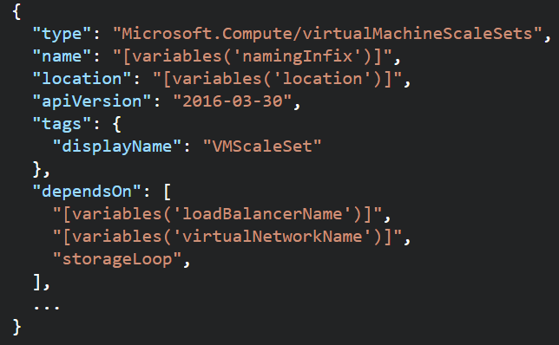
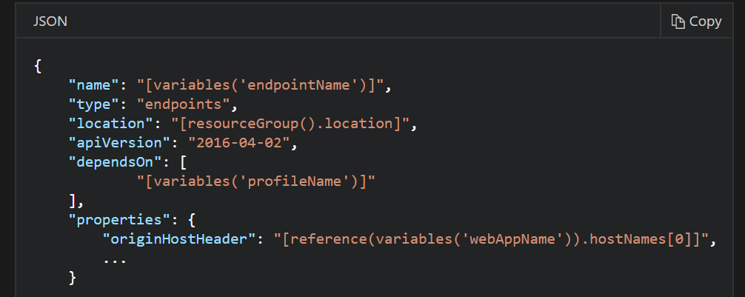
ARM Templates - Dependencies
Resources may require a dependency chain; e.g. You need a VNET before you can deploy a VM.
Use “dependsOn” property to explicitly build the dependencies between resources. Resources wont get created until their dependencies are created.
Use Child resources. Only certain resources can have child resources.
Use the “reference” function to create an implicit relationship. Resources that reference another resource are created after the referenced resource.
Notes:
https://docs.microsoft.com/en-us/azure/azure-resource-manager/resource-group-define-dependencies

Slide 53
ARM Templates Advanced Topics
Creating and Updating Resources in one ARM Template based deployment: https://docs.microsoft.com/en-us/azure/azure-resource-manager/resource-manager-update
Share state between linked templates: https://docs.microsoft.com/en-us/azure/azure-resource-manager/best-practices-resource-manager-state
Patterns for deploying resources: https://docs.microsoft.com/en-us/azure/azure-resource-manager/best-practices-resource-manager-design-templates

Slide 54
Deploy Templates

Slide 55
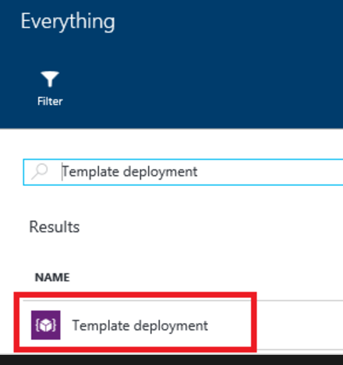
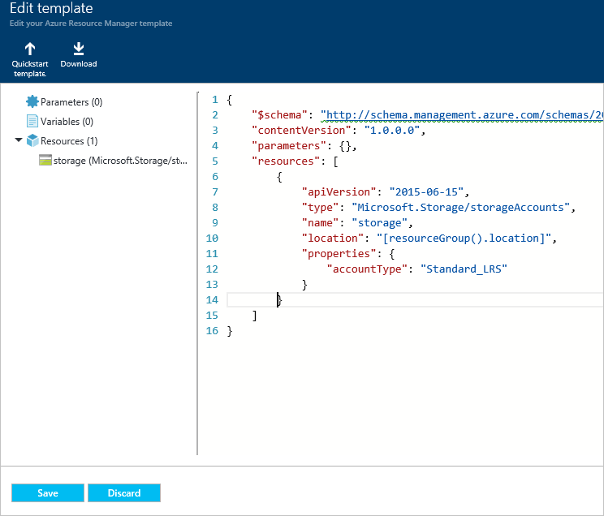
Deploy Templates – Portal, Custom Template

Slide 56
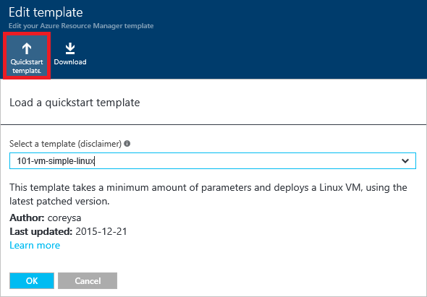
Deploy Templates – Portal, Quickstart

Slide 57
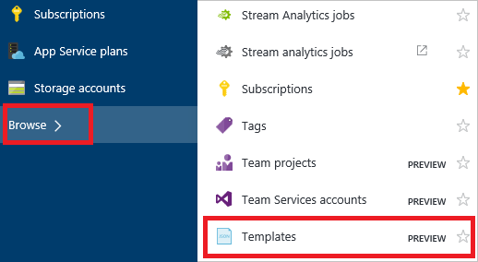
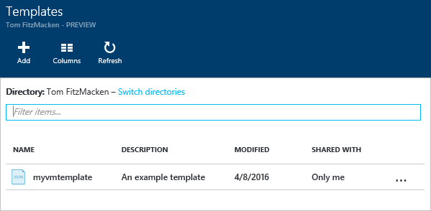
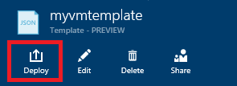
Deploy Templates – Portal, from Account

Slide 58
ARM Role Based Access Control

Slide 59
Deploy Templates – Portal
Create resource group
Deploy resources from Marketplace
Deploy resources from custom template
Deploy resources from a template saved to your account
Next Steps
https://docs.microsoft.com/en-us/azure/azure-resource-manager/resource-group-template-deploy-portal

Slide 60
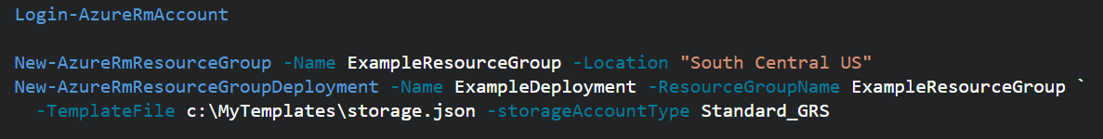
Deploy Templates - Powershell
Deploy a Template from a local json file
Deploy a Template from an external source:
Pass in a local parameter file:
Pass in an external parameter file

Slide 61
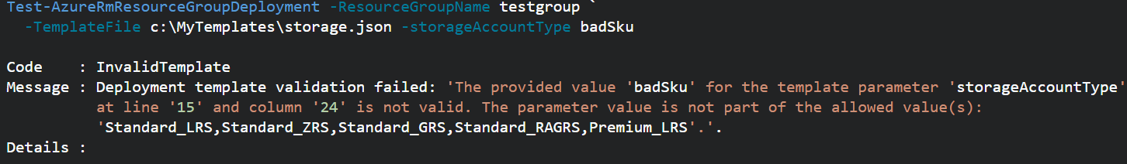
Deploy Templates - PowerShell
You can pass in parameters inline and with a local parameter file.
You CANNOT pass in parameters inline and with an external parameter file.
You can TEST a deployment before running it.
Template Deployments have 2 modes: INCREMENTAL or COMPLETE
Both modes deploy resources defined in Template.
Complete Deployment DELETES resources in group not defined in Template
Incremental does not DELETE resources not defined in Template
Use “-Mode” argument to set Mode.
Notes:
https://docs.microsoft.com/en-us/azure/azure-resource-manager/resource-group-template-deploy

Slide 62
Deploy resources with Resource Manager templates and Azure PowerShell
Deploy a template from your local machine
Deploy a template from an external source
Parameter files
Test a template deployment
Incremental and complete deployments
Sample template
Next steps
https://docs.microsoft.com/en-us/azure/azure-resource-manager/resource-group-template-deploy

Slide 63
Regional Availability

Slide 64
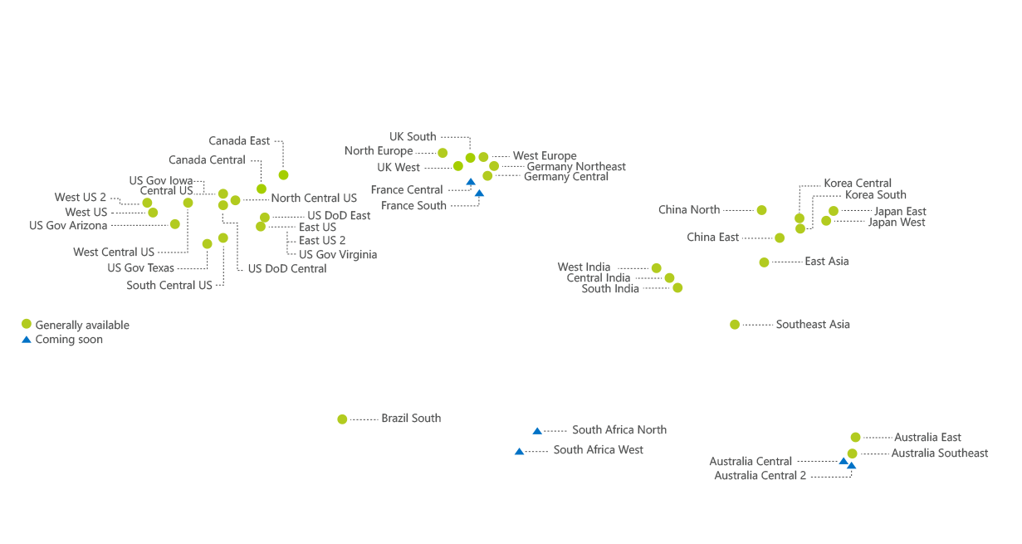

Regions
An Azure Region is a geographic region that contains a collection of data centers.
It’s more than one building.
Over 40 Azure regions
Special / Sovereign Regions
Notes:
An Azure Region is a geographic region that contains a collection of data centers. Datacenters will be in close geo proximity to each other – separate buildings
It’s more than one building.
There are over 36 Azure regions: https://azure.microsoft.com/en-us/regions/
Regions might have restrictions – eg. China - you might need a billing address in that country
All services might not be available in all regions
Special / Sovereign Regions:
US Gov Virginia/Iowa
China East, China North
Germany Central, Gemany Northeast

Slide 65
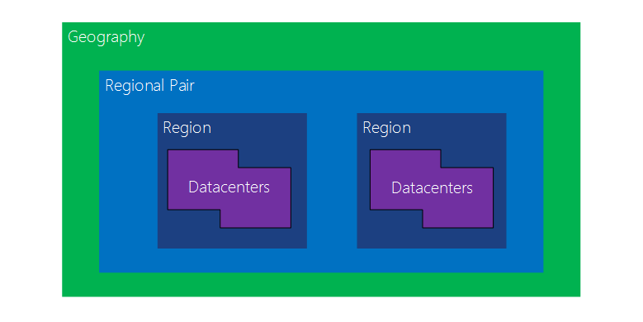
Regional Availability - Regions
Region Pairs
In same geography (such as US, Europe or Asia)
Replicated resources are replicated across pairs
In broad geographic outage, one region in the pair is prioritized
Data resides in the same geography as its pair (except Brazil South)
Azure Storage GRS and RA-GRS replicates data from one region to its pair.
Notes:
Datacenters are
An Azure Region is a geographic region that contains a collection of data centers.
It’s more than one building.
There are over 36 Azure regions: https://azure.microsoft.com/en-us/regions/
Special / Sovereign Regions:
US Gov Virginia/Iowa
China East, China North
Germany Central, Gemany Northeast
Region Pairs
In same geography (such as US, Europe or Asia)
Replicated resources are replicated across pairs
In broad geographic outage, one region in the pair is prioritized
Data resides in the same geography as its pair (except Brazil South)
Pairs: https://docs.microsoft.com/en-us/azure/best-practices-availability-paired-regions#what-are-paired-regions
Azure Storage GRS and RA-GRS replicates data from one region to its pair.

Slide 66
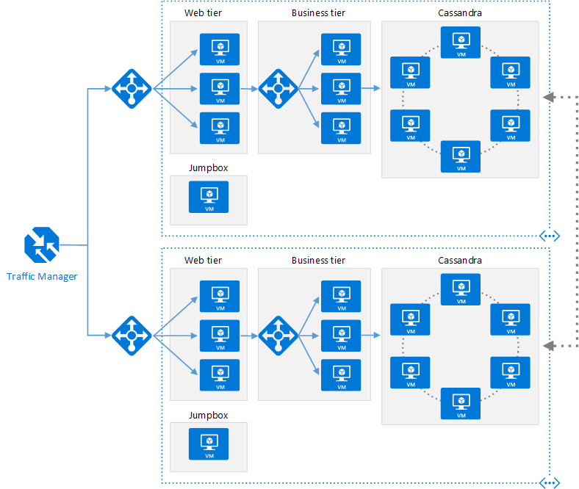
Regional Availability - Design
Primary/Secondary Region for Higher Availability
Traffic Manager routes requests
Put Primary, Secondary and Traffic Manager is separate regions
Make sure each region’s VNET IP range does not overlap
The same ARM template can be deployed, with minor parameter changes for VNET IP address space, and Resource locations.
Notes:
Microsoft Azure Traffic Manager allows you to control the distribution of user traffic for service endpoints in different datacenters. Service endpoints supported by Traffic Manager include Azure VMs, Web Apps, and cloud services. You can also use Traffic Manager with external, non-Azure endpoints.+
Traffic Manager uses the Domain Name System (DNS) to direct client requests to the most appropriate endpoint based on a traffic-routing method and the health of the endpoints. Traffic Manager provides a range of traffic-routing methods and endpoint monitoring options to suit different application needs and automatic failover models. Traffic Manager is resilient to failure, including the failure of an entire Azure region.

Slide 67
Regional Availability - Design
Configurations
Active/passive with hot standby (rec)
Active/passive with cold standby
Active/active
Use Regional Pairing
In broad outage, one region from pair is prioritized
Data residency issues mitigated
Traffic Manager
routing = priority,
health probe = write a custom service that reports accurately
Read Reference Architecture Here.
https://docs.microsoft.com/en-us/azure/architecture/reference-architectures/virtual-machines-linux/multi-region-application

Slide 68
High Availability
Availability within a region vs. Regional Availability
Azure Storage makes 3 copies of data within a region (including VM disks)
Use Availability Sets
Design loosely coupled service with asynchronous communication. Use Azure Storage queues or Azure Sevice Bus for queue-centric workflow.
Fault Detection and Retry Logic within your application
Circuit Breaker Pattern
Immutable Infrastructure, Infrastructure as Code
https://docs.microsoft.com/en-us/azure/architecture/resiliency/high-availability-azure-applications
https://docs.microsoft.com/en-us/azure/architecture/resiliency/index#designing-for-resiliency

